Slide 1

Automation for QCA
Module 3: Building Object
Repositories

Slide 2
Module 3 Objectives
At the end of this module, participants will be able to understand:
Object Repositories
Element Descriptors
Element Provider Implementations
XML
EXCEL
CSV

Slide 3

Course Map / Module Map
Module 8
Module 7
Module 6
Module 5
Module 4
Module 3 Map
Object Repos tories
Element Descriptors
Element Provider Implementations
Demo
Activity
Building Object Repositories
Module 2
Module 1

Slide 4
Module 3 Design Outline
Object Repositories
Element Provider Implementations (CSV, XML and Excel)
Demo
Element Descriptors
Activity

Slide 5
Module 3 Design Outline
Object Repositories
Element Provider Implementations (CSV, XML and Excel)
Demo
Element Descriptors
Activity

Slide 6

Object Repositories
The Object Repository allows for a powerful yet simple to use repository for storing page and element data.
Designed using the concept of Separation of Responsibility, one group can be responsible for select and naming object of interest on the page while another can be responsible for identifying those objects and storing the values using one of the specified element providers.

Slide 7
Object Repository – Simple Scenario (1 of 2)
To understand the importance of Object Repository, we will consider a scenario in URL https://www.allstate.com/
Let us assume that there are 100 test cases and in all the test cases, we have Login to My Account scenario. If the application has been changed now and some locator changes, like Login by (User Name) changes to Login by (Email) then we have to modify all the test cases and we have to change the Login by (User Name).

Slide 8
Object Repository – Simple Scenario (2 of 2)
This process does not make any sense, so to overcome with this we will move all locators in a separate file and we will link all test cases to this file.
So if any changes happen in our locator we will simply change in that file, not in our test cases.
This will increase the modularity of test cases.

Slide 9
Module 3 Design Outline
Object Repositories
Element Provider Implementations (CSV, XML and Excel)
Demo
Element Descriptors
Activity

Slide 10
Element Descriptors (2 of 2)
Various Element Descriptors
XPATH
CLASS
CSS
ID
LINK_TEXT
NAME
TAG_NAME
HTML
V_TEXT
V_IMAGE

Slide 11
Element Descriptors – XPATH ( 1 of 2)
XPATH is a language for traversing the structure of the DOM (document object model) of the web page.
XPATH locators are very powerful and flexible. Any element on the page can be located via one or more XPATHs and most other locators can be expressed as an XPATH.
A well-written XPATH can be very robust, but a poor XPATH can be fragile – meaning that it may break when the application changes.

Slide 12
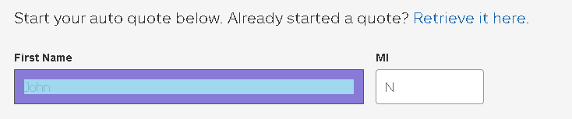
Element Descriptors – XPATH ( 2 of 2)
Use the XPATH query language to select Text Box
//*[@id="first_name"]

Slide 13

Element Descriptors - CSS
The CSS Class locator finds the first element with a definite CSS class attribute. This is useful for locating items that have a unique style on the page.
A common example of CSS class locator is submit and login/logout buttons – because there is frequently only one control on the page with that style.
Lookup by CSS path for “Submit a Claim Now”
html body form#aspnetForm div#wrapper div#mainContent div#frm.frmbodyNoSidebar div#buttons.waterFrmbuttons input#ctl00_frmPlaceholder_btn_submit.frmButton

Slide 14
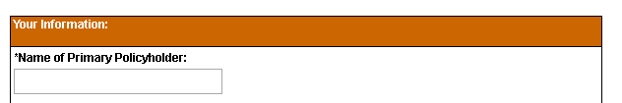
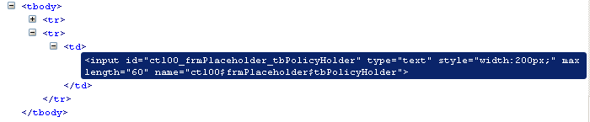
Element Descriptors - ID
The ID is an identifier for the element that is typically assigned by the developer of the code.
From below snippet we would identify Name of the Primary Policyholder by ID .
<element name="Name_of_Primary_Policyholder_TextBox" descriptor="ID" value="ctl00_frmPlaceholder_tbPolicyHolder" />

Slide 15
Element Descriptors – LINK_TEXT
The link_text locator looks for elements that contained with the supplied text. It is easy to find links and buttons on the page that have visible text (but not an image that contains the text).
It is implemented with an XPATH locator that looks at these items (in this order):
Button labels
Input values (e.g. text fields, etc.)
Link text
Labels
Elements with a title attribute
Elements with text
Link Text
Example:-
<element name="SCHEDULE_LATER_LINK" descriptor="LINK_TEXT" value="Schedule Later" />

Slide 16
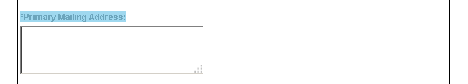
Element Descriptors - NAME
Each input field in a form has a name. In general, field names are unique to the form, but this condition is not true always.
A Field Name locator for username and password fields on a login page usually work good. But in a radio button of a related group will have the same name and different values, so a different locator must be used to click on a specific button in the group. In the below snippet, the input field could be easily located using either the id or the field name.
<element name="Primary_Mailing_Address_TextArea" descriptor="NAME" value="ctl00$frmPlaceholder$tbMailingAddress" />

Slide 17
Other Element Descriptors
Element Descriptors | Description
Tag_name | Find and element by tag name
Html | Find and element using HTML properties similar to the HP UFT HTML Element lookups Link(‘html tag:=a’) Web Element(‘html tag:=span’ , ‘innerText:=*Cart.*’)
V_text | Locate an element using OCR. This is visual lookup and will use the visual location to identify the underlying element Any Text
V_image | Locate an element by image. This will use image comparison to find an image on the screen by loading the named image from the Perfecto Repository

Slide 18
Module 3 Design Outline
Object Repositories
Element Provider Implementations (CSV, XML and Excel)
Demo
Element Descriptors
Activity

Slide 19
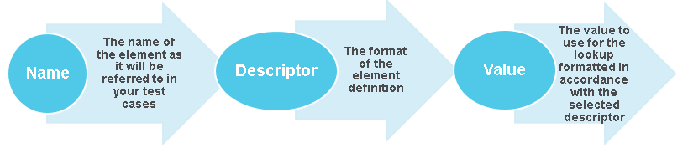
Element Provider Implementation – XML(1 of 2)
The elements will be provided using a structured XML file. The file must be in adherence with the XML Schema definition.
The elements will be contained within named SITE and PAGE element and will contain that following named attributes Name, Descriptor and Value

Slide 20
Element Provider Implementation – XML(2 of 2)
The following example device using XPATH as the descriptor type.
<?xml version="1.0" encoding="UTF-8"?>
<elementDefinition xmlns="http://www.xframium.org/pageRegistry" xmlns:xsi="http://www.w3.org/2001/XMLSchema-instance" xsi:schemaLocation="http://www.xframium.org/pageRegistry http://www.xframium.org/xsd/pageManagement/pageRegistry.xsd">
<site name="FloodLoss">
<page name="Submit_Claim_Form">
<element name="Your_Information_Header" descriptor="XPATH" value="//span[text()='Your Information:']" />

Slide 21
Element Provider Implementation – XML(2 of 2)
The following example device usage of XPATH as the descriptor type
<page name="Claim_Report">
<element name="Name_of_Primary_Policyholder_Value" descriptor="XPATH" value="//span[text()='Name of Primary Policyholder:']/../../td[2]/span" />
<element name="Back_Button" descriptor="ID" value="ctl00_frmPlaceholder_btn_back" />
<element name="Printable_Version" descriptor="ID" value="ctl00_frmPlaceholder_btn_print" />
</page>

Slide 22
Element Provider Implementation – Excel(1 of 2)
The elements will be provided using an Excel based spreadsheet. When using this provided each site is defined by using a named Tab or Sheet. The format of the data in the named sheet for a site is:
Page: The name of the page that this element belongs to
Element Name: The name of the element as it will be referred to in your test cases
Descriptor: The format of the element definition
Value: The value to use for the lookup formatted in accordance with the selected descriptor
Page
Element Name
Descriptor
Value

Slide 23
Element Provider Implementation - Excel(2 of 2)
The following example device usage of XPATH as the descriptor type
Page | Element Name | Descriptor | Value
Claim Report | Name_of_Primary_Policyholder_Value | XPATH | //span[text()='Name of Primary Policyholder:']/../../td[2]/span
page name="Claim_Report">
<element name="Name_of_Primary_Policyholder_Value" descriptor="XPATH" value="//span[text()='Name of Primary Policyholder:']/../../td[2]/span" />

Slide 24
Element Provider Implementation - CSV
The elements will be provided using a CSV file. The comma separated values must be supplied in the following order:
Site: The name of the site or application that these pages belong to
Page: The name of the page that this element belongs to
Element Name: The name of the element as it will be referred to in our test cases
Descriptor: The format of the element definition
Value: The value to use for the lookup formatted in accordance with the selected descriptor
Site
Page
Element Name
Descriptor
Value

Slide 25
Module 3 Design Outline
Object Repositories
Element Provider Implementations (CSV, XML and Excel)
Demo
Element Descriptors
Activity

Slide 26
Demo (1 of 4)
We are considering Flood Loss application for capturing the page elements
Navigate to Flood loss application by URL:-
https://messaging-stest.allstate.com/floodloss.aspx
Note:- Participants are requested to go through the previous modules for understanding and creation of folder structure for the Floodloss application.
Step 1: Under floodloss-Demo folder create Floodloss-WebPageElements.xml file.
Step 2: Identify and describe various page elements (using XML descriptors) that were available in the Landing page of Floodloss sample application.
Step 3: Check properly whether XML elements were identified and located correctly.

Slide 27
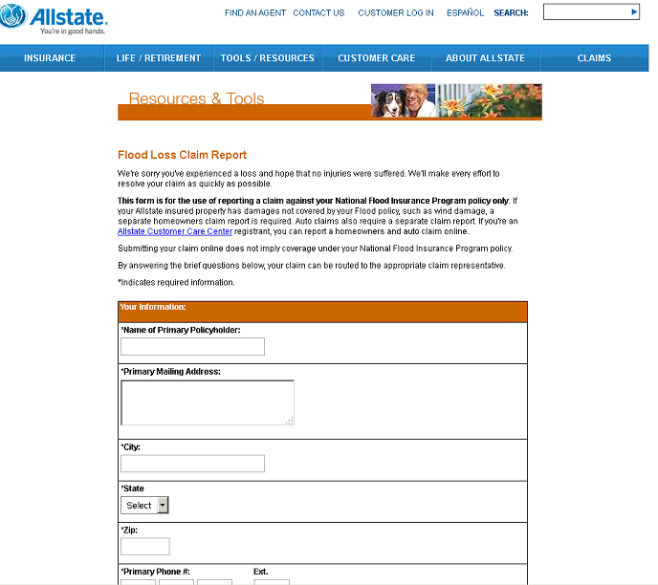
Demo (2 of 4)
Landing Page for Flood Loss sample Application

Slide 28
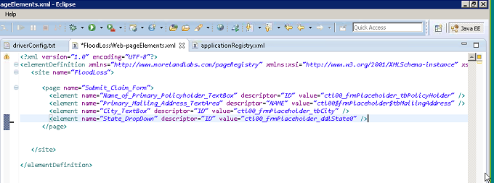
Demo (3 of 4)
Identifying/Scripting the page elements in FloodlossWeb-pageElements.xml file
Note: We need to update the driverConfig.txt with Page Object Configuration
of Flood loss sample application

Slide 29
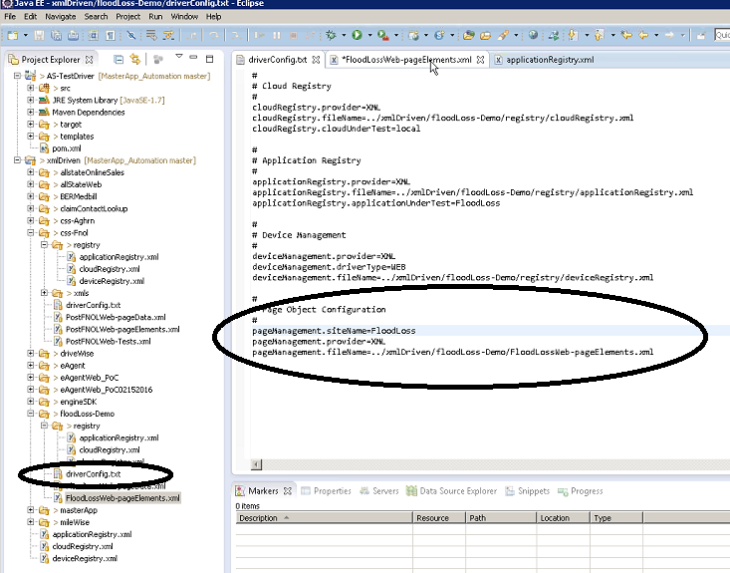
Demo (4 of 4)
Updating the page Object Configuration
DeviceConfig.txt file

Slide 30
Module 3 Design Outline
Object Repositories
Element Provider Implementations (CSV, XML and Excel)
Demo
Element Descriptors
Activity

Slide 31

Activity
Environment or File: Participants Guide
Steps:
Open the Participants Guide given as word document.
Read the given activity details.
Complete the activities
Submit to faculty

Slide 32
Summary
At the end of this module, participants are able to understand:
Overview of building object repository
Element Descriptors
Element Provider Implementaions (CSV, Excel etc)

Slide 33


